Slide 1
LECTURE 1 NET FRAMEWORK
Introduction to C# Programming

Slide 2
.Net provides
Integrated environment
Internet, Desktop , Mobile devices
consistent object-oriented
To provide a portable environment
A managed environment

Slide 3
What Is .NET
.NET is a framework
New programming methodology
.NET is platform independent / cross platform
.NET is language-insensitive

Slide 4
.NET is cross-platform
APP.exe
?
Win64
Win32
(XP,2K,98)
WinCE

Slide 5
Narrow view of .Net applications
.NET Application
.NET Framework
Operating System + Hardware

Slide 6
.Net Architecture
.NET architecture is:
multi-language
cross-platform
based on the CLR, FCL, and JIT technology
.NET components are packaged as assemblies

Slide 7
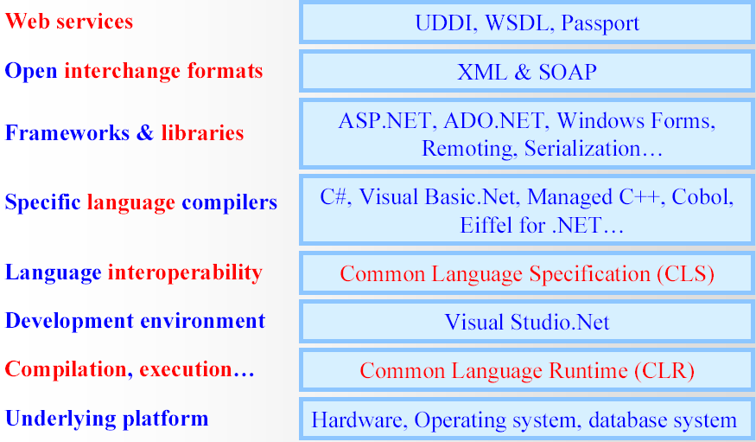
.Net Architecture

Slide 8
.Net Technical Architecture
VB
C++
C#
JScript
…
Visual Studio.NET
Common Language Specification
ASP.NET: Web Services
and Web Forms
Windows Forms
Windows Forms
ADO.NET: Data and XML
Base Class Library
Common Language Runtime

Slide 9
Common Language Runtime
A common runtime for all .NET languages
Common type system
Common metadata
Intermediate Language (IL) to native code compilers
Memory allocation and garbage collection
Code execution and security
Over 15 languages supported today
C#, VB, Jscript, Visual C++ from Microsoft
Perl, Python, Smalltalk, Cobol, Haskell, Mercury, Eiffel, Oberon, Oz, Pascal, APL, CAML, Scheme, etc.
Rational is working on Java compiler for CLR

Slide 10
The CLR Architecture
Base Class Library Support
Thread Support
COM Marshaler
Type Checker
Exception Manager
Security Engine
Debug Engine
MSIL to Native
Compilers (JIT)
Code
Manager
Garbage
Collector (GC)
Class Loader

Slide 11
CLR Execution Model (Narrow)
Code in VB.NET
Code in C#
Code in another
.NET Language
VB.NET compiler
C# compiler
Appropriate
Compiler
IL(Intermediate
Language) code
CLR just-in-time
execution

Slide 12
CLR Execution Model
Source code
VB
C#
C++
Unmanaged
Component
Compiler
Compiler
Compiler
Managed
code
Assembly
IL Code
Assembly
IL Code
Assembly
IL Code
Common Language Runtime
JIT Compiler
Native Code
Operating System Services

Slide 13
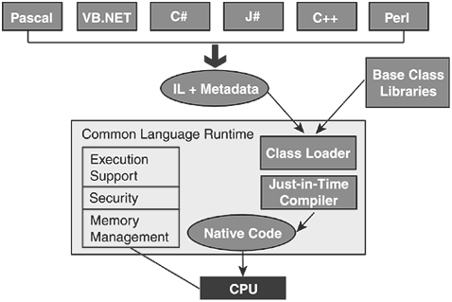
How CLR works?

Slide 14
CLR based execution
APP.exe
OS Process
CLR
JIT Compiler
other FCL components
Core FCL
obj code
Underlying OS and HW

Slide 15
Common Language Runtime
Execution Engine
Compiles Microsoft Intermediate Language (MSIL) into native code
Handles garbage collection
Handles exceptions
Enforces code access security
Handles verification
Managed v. Unmanaged

Slide 16
Implications of CLR execution model
Clients need CLR & FCL to run .NET apps
available via Redistributable .NET Framework
Design trade-off…
managed execution (memory protection, verifiable code, etc.)
portability:
slower execution?

Slide 17
CLR and JIT compiling.
Indirect execution of .Net applications.
All .NET languages compile to the same CIL.
The CLR transforms the CIL to assembly instructions for a particular hardware architecture.
This is termed jit’ing or Just-in-time compiling.
Some initial performance cost, but the jitted code is cached for further execution.
The CLR can target the specific architecture in which the code is executing, so some performance gains are possible.

Slide 18
Advantages of CLR
Support for developer services (debugging)
Interoperation between managed code and unmanaged code (COM, DLLs).
Managed code environment
Improved memory handling
Improved “garbage collection”

Slide 19
Advantages of CLR
JIT allows code to run in a protected environment as managed code.
JIT allows the IL code to be hardware independent.
CLR also allows for enforcement of code access security.
Verification of type safety.
Access to Metadata (enhanced Type Information)

Slide 20
Common Language Infrastructure

Slide 21
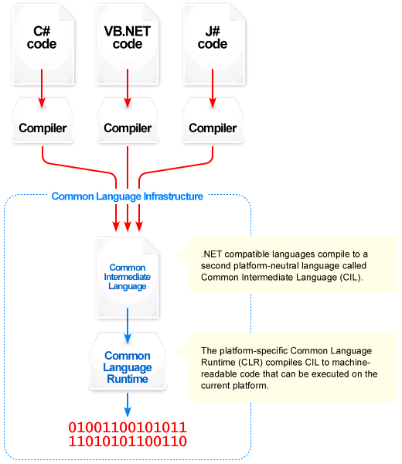
CLI

Slide 22
Common Language Infrastructure
CLI allows for cross-language development.
Four components:
Common Type System (CTS)
Meta-data in a language agnostic fashion.
Common Language Specification – behaviors that all languages need to follow.
A Virtual Execution System (VES).

Slide 23
Common Type System (CTS)
A specification for how types are defined and how they behave.
no syntax specified
A type can contain zero or more members:
Field
Method
Property
Event

Slide 24
Common Type System (CTS)

Slide 25
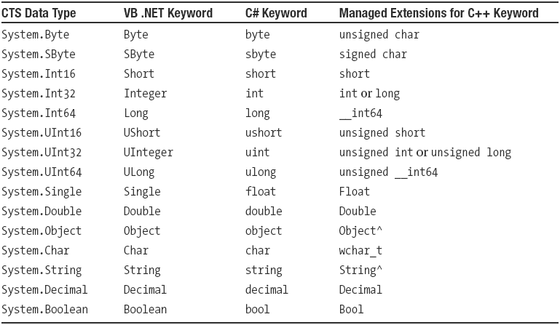
CTS Data Types

Slide 26
Common Data Types
CLR provides a set of primitive types that all languages must support. The data types include:
Integer—three types 16/32/64 bits
Float—two types: 32/64 bits
Boolean and Character
Date/time and Time span
The primitive types can be collected into
Arrays
Structures
Combination of the two

Slide 27
Common Language Specification (CLS)
Not all languages support all CTS types and features
C# is case sensitive, VB.NET is not
C# supports pointer types (in unsafe mode), VB.NET does not
C# supports operator overloading, VB.NET does not
CLS was drafted to promote language interoperability
vast majority of classes within FCL are CLS-compliant

Slide 28
Comparison to Java
Hello.java
Hello.class
JVM
compile
execute
Source code
Byte code
Hello.vb
Hello.exe
CLR
compile
execute
Source code
CIL

Slide 29
Base Class Library

Slide 30
Base Class Library
Similar to Java’s System namespace.
Used by all .NET applications
Has classes for IO, threading, database, text, graphics, console, sockets/web/mail, security, cryptography, COM, run-time type discovery/invocation, assembly generation

Slide 31
Framework Class Library @ BCL
Single consistent set of object oriented class libraries to enable building distributed web applications (Unified Classes)
Built using classes arranged across logical hierarchical namespaces
Work with all CLR languages
No more “VBRun” or “MFC” divide

Slide 32
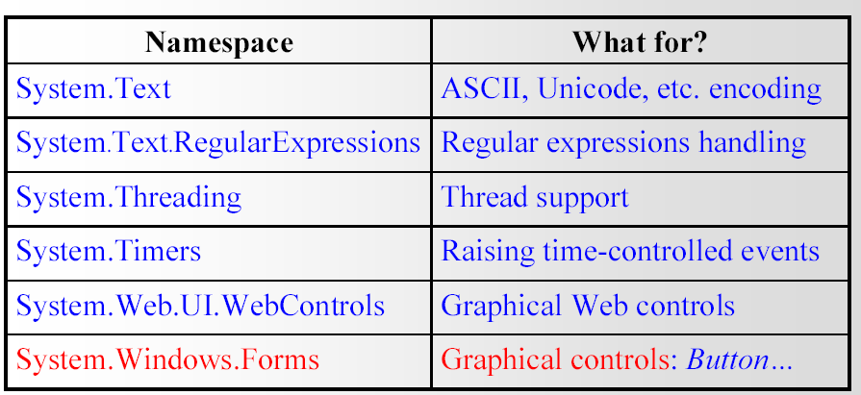
Example

Slide 33
Intermediate Language (IL)
.NET languages are not compiled to machine code. They are compiled to an Intermediate Language (IL).
CLR accepts the IL code and recompiles it to machine code. The recompilation is just-in-time (JIT) meaning it is done as soon as a function or subroutine is called.
The JIT code stays in memory for subsequent calls. In cases where there is not enough memory it is discarded thus making JIT process interpretive.

Slide 34
LITERATURE
MUST READ
ENGLISH
Pro C# 5.0 and the .NET 4.5 Framework, 6th Edition
OR RUSSIAN
Герберт Шилдт - C# 4.0. Полное руководство - 2011
WHERE TO GET
https://yadi.sk/i/bul4cKiKiner3 https://yadi.sk/i/H4N_pjJfinesG

